Slide 1
Subnetting/Supernetting and
Classless Addressing

Slide 2
CONTENTS
SUBNETTING
SUPERNETTING
CLASSLESS ADDRSSING

Slide 3

5.1
SUBNETTING

Slide 4

IP addresses are designed with two levels of hierarchy.

Slide 5
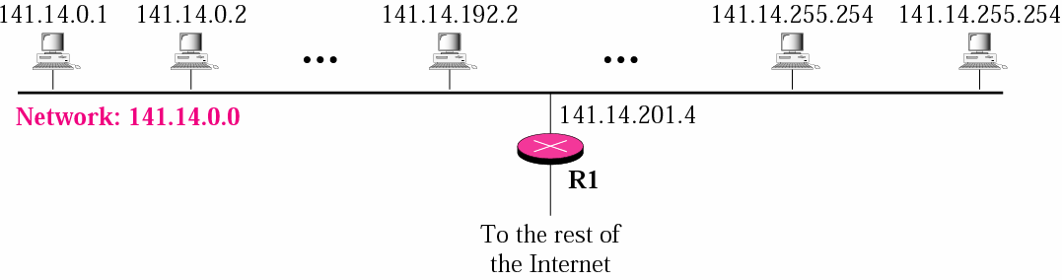
A network with two levels of hierarchy (not subnetted)
Figure 5-1

Slide 6
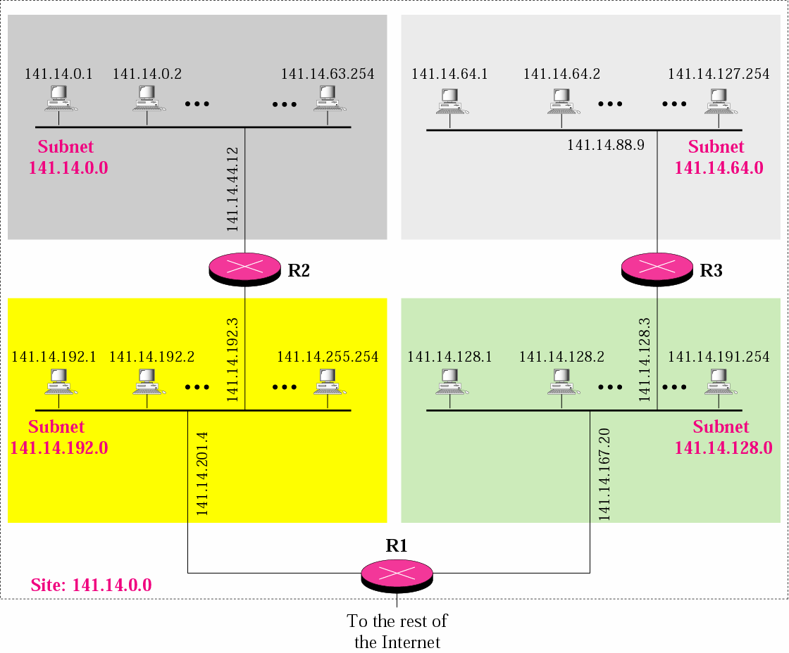
A network with three levels of hierarchy (subnetted)
Figure 5-2

Slide 7
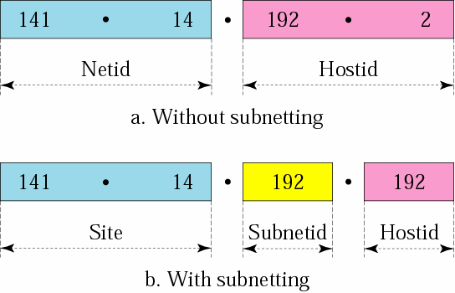
Addresses in a network with and without subnetting
Figure 5-3

Slide 8

Hierarchy concept in a telephone number
Figure 5-4

Slide 9
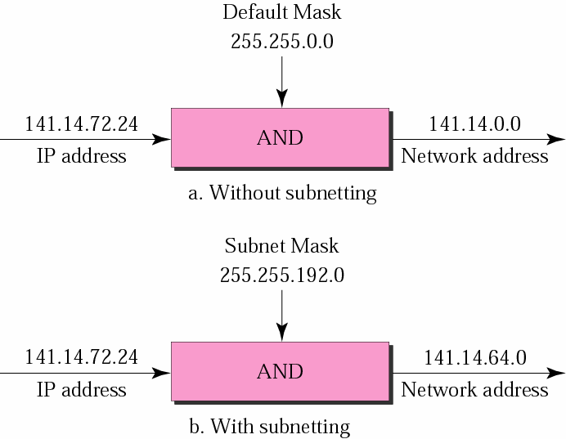
Default mask and subnet mask
Figure 5-5

Slide 10
Finding the Subnet Address
Given an IP address, we can find the subnet address the same way we found the network address in the previous chapter.
We apply the mask to the address. We can do this in two ways: straight or short-cut.

Slide 11
Straight Method
In the straight method, we use binary notation for both the address and the mask and then apply the AND operation to find the subnet address.

Slide 12
Example 1
What is the subnetwork address if the destination address is 200.45.34.56 and the subnet mask is 255.255.240.0?

Slide 13
Solution
11001000 | 00101101 | 00100010 | 00111000
11111111 | 11111111 | 11110000 | 00000000
11001000 | 00101101 | 00100000 | 00000000
The subnetwork address is 200.45.32.0.

Slide 14
Short-Cut Method
** If the byte in the mask is 255, copy the byte in the address.
** If the byte in the mask is 0, replace the byte in the address with 0.
** If the byte in the mask is neither 255 nor 0, we write the mask and the address in binary and apply the AND operation.

Slide 15
Example 2
What is the subnetwork address if the destination address is 19.30.80.5 and the mask is 255.255.192.0?
Solution
See Figure 5.6

Slide 16
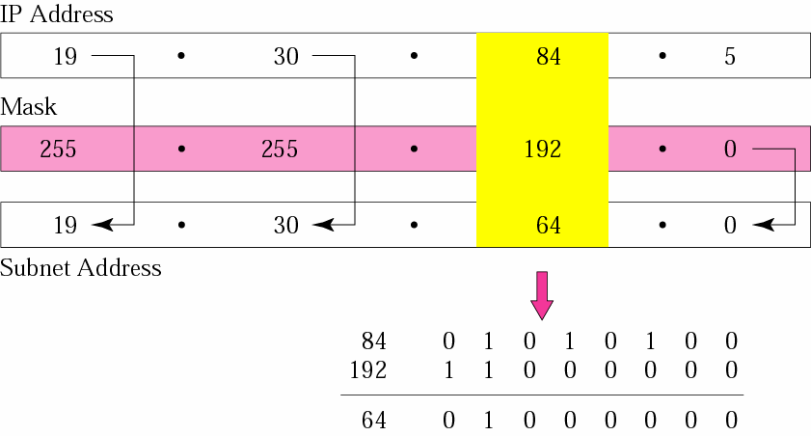
Example 2
Figure 5-6

Slide 17
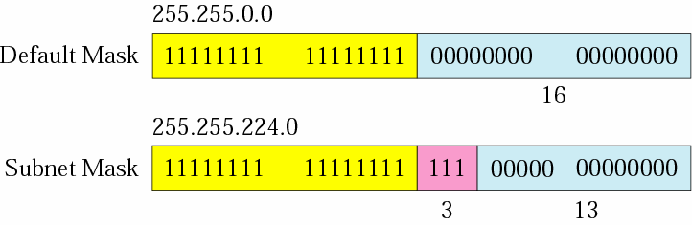
Comparison of a default mask and a subnet mask
Figure 5-7

Slide 18
The number of subnets must be a power of 2.

Slide 19
Example 3
A company is granted the site address 201.70.64.0 (class C). The company needs six subnets. Design the subnets.
Solution
The number of mask is 24 (class C).
1s in the default

Slide 20
Solution (Continued)
The company needs six subnets. This number 6 is not a power of 2. The next number that is a power of 2 is 8 (2³). We need 3 more 1s in the subnet mask. The total number of 1s in the subnet mask is 27 (24 + 3).
The total number of 0s is 5 (32 − 27). The mask is

Slide 21
Solution (Continued)
11111111 11111111 11111111 11100000
or
255.255.255.224
The number of subnets is 8.
The number of addresses in each subnet is 2⁵ (5 is the number of 0s) or 32.
See Figure 5.8

Slide 22
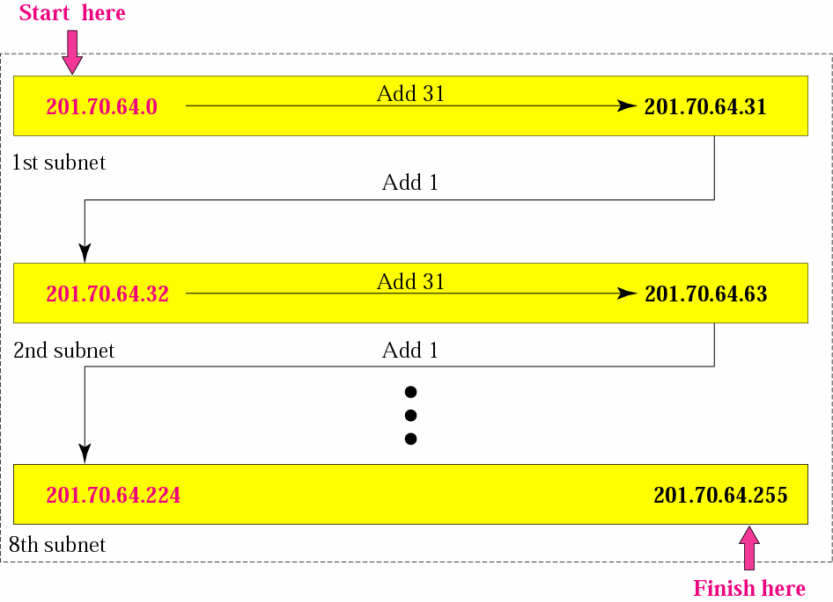
Example 3
Figure 5-8

Slide 23
201.70.64.000 00000-207.70.64.00011111 201.70.64.00100000-201.70.64.00111111 201.70.64.01000000-201.70.64.01011111 201.70.64.01100000-201.70.64.01111111 201.70.64.10000000-201.70.64.10011111 ; ; 201.70.64.1110000-201.70.64.11111111

Slide 24
Example 4
A company is granted the site address
181.56.0.0 (class B). The company needs 1000 subnets. Design the subnets.
Solution
The number of 1s in the default mask is 16 (class B).

Slide 25
Solution (Continued)
The company needs 1000 subnets. This number is not a power of 2. The next number that is a power of 2 is 1024 (2¹⁰). We need 10 more 1s in the subnet mask.
The total number of 1s in the subnet mask is 26 (16 + 10).
The total number of 0s is 6 (32 − 26).

Slide 26
Solution (Continued)
The mask is
11111111 11111111 11111111 11000000
or
255.255.255.192.
The number of subnets is 1024.
The number of addresses in each subnet is 2⁶ (6 is the number of 0s) or 64.
See Figure 5.9

Slide 27
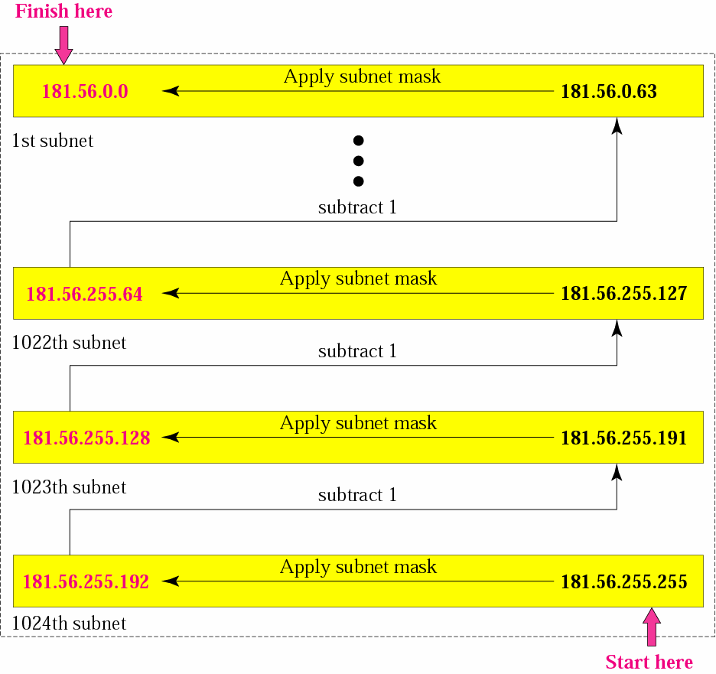
Example 4
Figure 5-9

Slide 28
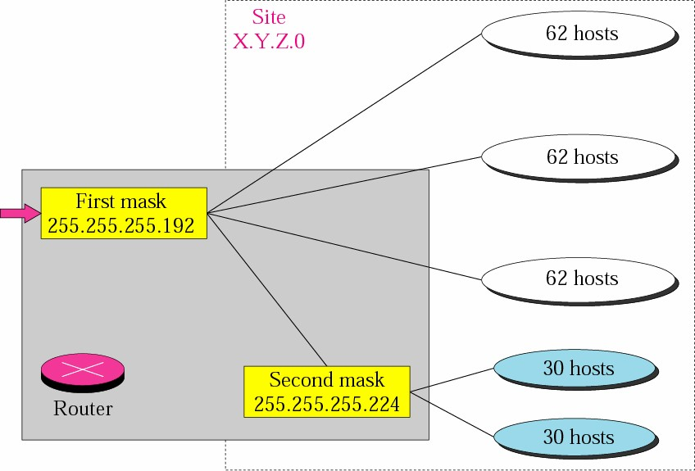
Variable-length subnetting
Figure 5-10

